Slide 1

Building Modern Mobile Apps - Cordova
Kevin E Ford
Mobile Practice Lead
Magenic
Level: Introductory

Slide 2
Kevin Ford
KevinF@magenic.com
@Bowman74
http://windingroadway.blogspot.com
https://github.com/Bowman74
BrentE@magenic.com
@brentledwards
http://www.brentedwards.net
https://github.com/brentedwards
Brent Edwards

Slide 3
Mobile Tasks Source Code
GitHub
https://github.com/brentedwards/MobileTasks

Slide 4
What is Cordova Development?

Slide 5
Cordova History
Originally Nitobi
Purchased by Adobe in 2011
Cordova Open Source (Apache 2.0 License)
PhoneGap Product Version of Cordova

Slide 6
IDEs

Slide 7
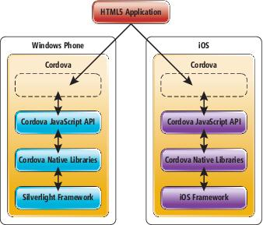
How does Cordova Work?

Slide 8


Supported Platforms?
Notes:
Android 2.3.3 and later (4.4 provides the best developer experience)
iOS 6, 7, and 8
Windows 8 and 8.1
Windows Phone 8 and 8.
Windows Universal

Slide 9





What do I need?
Notes:
This stuff is installed for you.

Slide 10
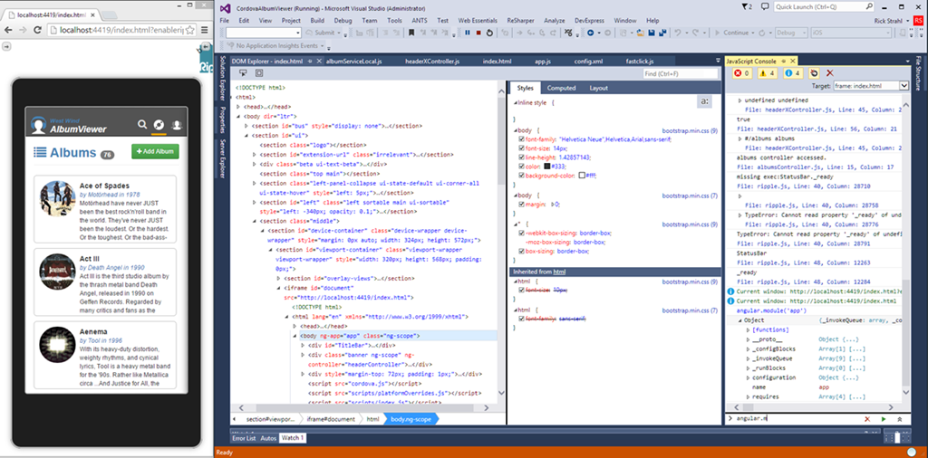
Emulator Options - Ripple
Notes:
Cordova Simulate

Slide 11
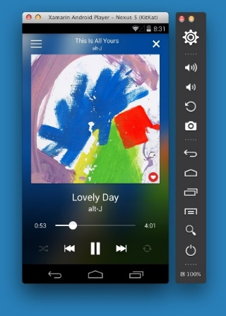
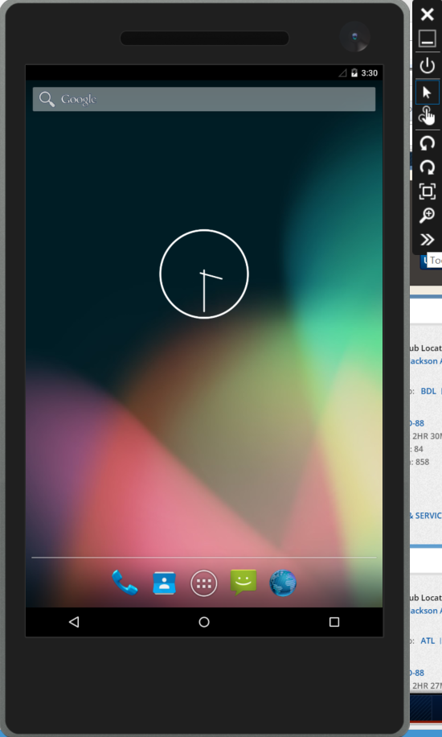
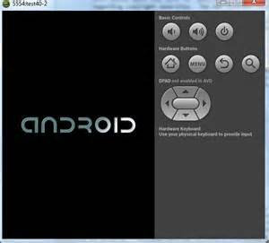
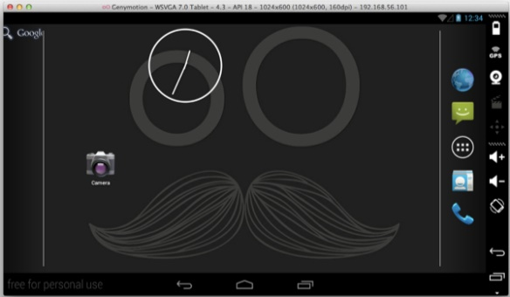
Emulator Options - Android
Mac OS with HAXM Atom
Windows with Hyper-V

Slide 12
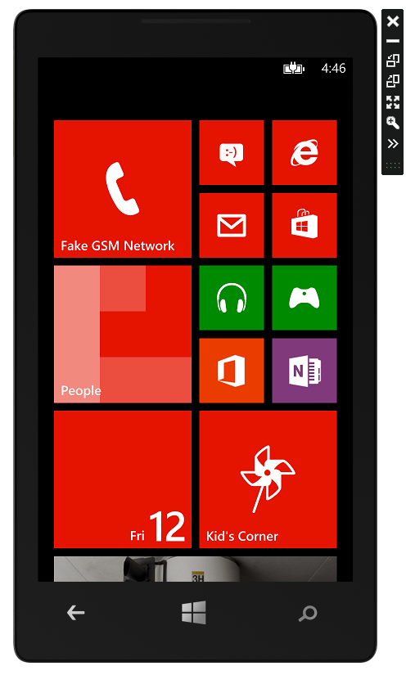
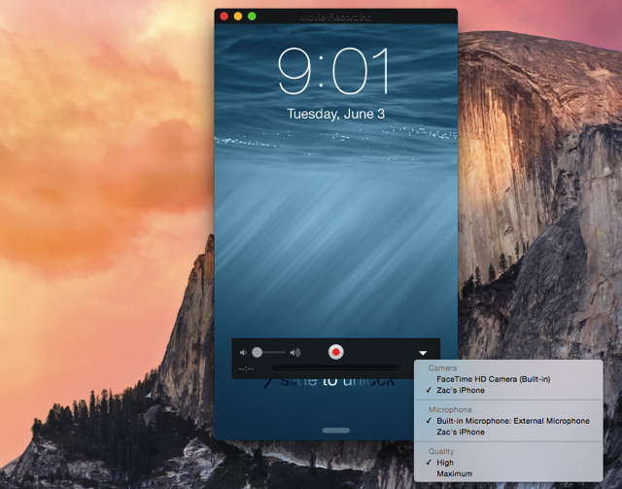
iOS and Windows Phone

Slide 13
Plugins
Listed in config.xml
Cross Platform API Access in JavaScript
Written in Native Languages (Objective-C, Java, C#)
Plugin Directory - http://cordova.apache.org/plugins/
Abstraction APIs Can Hide Native Features
Changes May Lag Latest Platform Changes

Slide 14
Libraries and Scripts

Slide 15

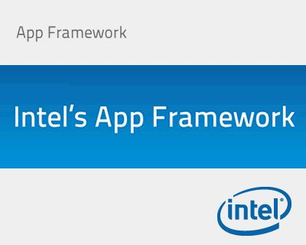






What about the UI?

Slide 16
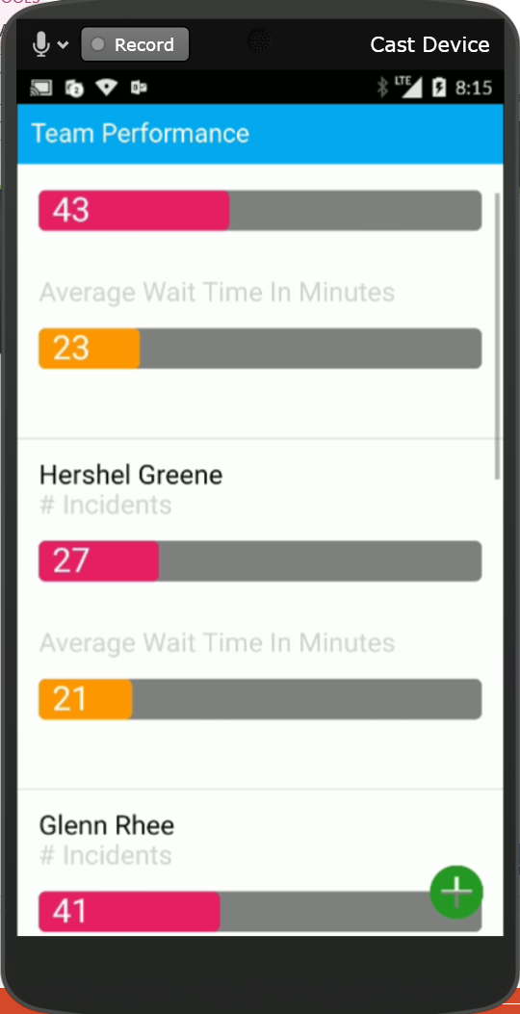
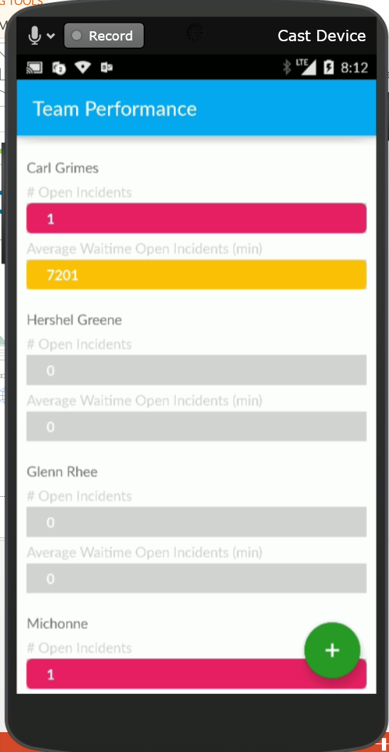
A Tale of Two Apps

Slide 17
Adding an UI Framework

Slide 18
About Ionic 2
Uses Angular 2
Styles UI
Extra Utilities
Ionic Lab
Live Reload
App Viewer

Slide 19
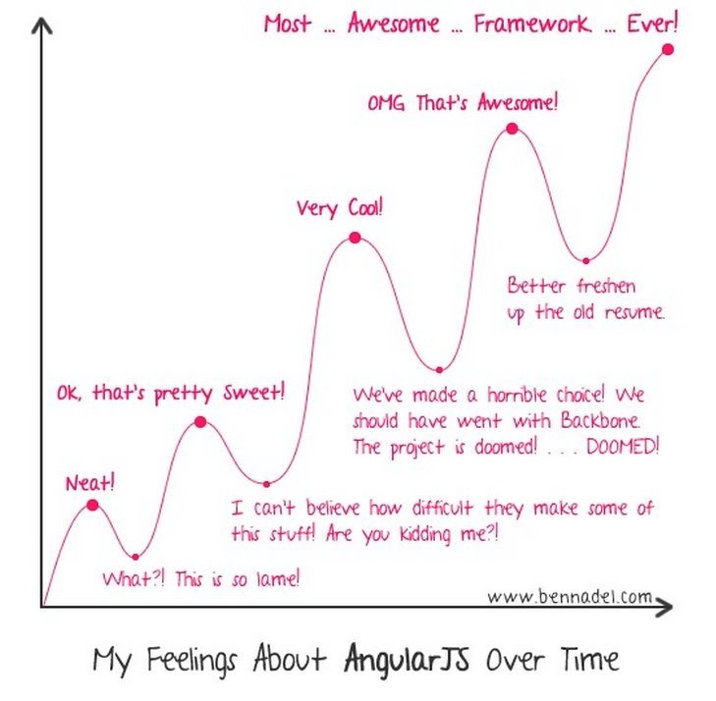
Angular Learning Curve

Slide 20
Angular – Single Page Application
Main Page
View 1
<html>
<script src="build/main.js"></script>
<body>
<ion-app>
View 2
View 1
View 2
View 3
View 1
View 4
View 3
View 4
</ion-app>
</body>
</html>

Slide 21
Setting up Ionic
npm install –g cordova ionic
Ionic start <app name> <app type> --v2
App Types: blank, tabs, sidemenu, slide
To work in Visual Studio with TACO
http://taco.visualstudio.com/en-us/docs/tutorial-ionic2/

Slide 22
Creating a Page
Basic Structure
Pages
<ion-content>
</ ion-content >
List
<ion-list>
<ion-item></ion-item>
</ion-list>

Slide 23
Binding
Create variables in controller using ‘this’
public registration: Registration;
Display: <ion-item>{{ registration.ScreenName }} </ion-item>
Edit: <ion-input data-ng-style="width: 50%" id="txtName" [(ngModel)] ="MyName" />

Slide 24
Validation/Formatting Syntax
Formatting
<ion-item>{{ Name | uppercase }}</ion-item>
<ion-item>{{ OtherName | lowercase }}</ion-item>
<ion-item>{{ SomeDate | date:'MM-dd-yyyy' }}</Ion-item>
Validation
<ion-input type="text" id="txtName" [(ngModel)] =“MyText" required />
<ion-input type="text" id="txtName" [(ngModel)] ="MyText" required="" minlength="4" maxlength="24" />
<ion-datetime required displayFormat="MM/DD/YYYY" id="txtDate" [(ngModel)] =“MyDate” />
Errors
<div [hidden]="!MyText.errors.minlength">
Text must be at least 4 characters long.
</div>
<div [hidden]="!MyText.errors.maxlength">
Text cannot be more than 24 characters long.
</div>

Slide 25
Connecting to Azure
Installed via Plugin
Asnyc done via callback (.done {} )
Table Result Format: result[record index][field name]
Json handling via GSon

Slide 26
When to Use
Cost Primary Driver
Can stay within the bounds of what the plugins do out of the box
Need good but not pixel perfect UI
Need good but not great performance
Writing for multiple platforms

Slide 27
Conclusion
Fastest way to Create X-Platform Apps
UI Compromises
Plugin Limitations – often lag behind changes
Can use Node.js for Unified Stack
Performance Compromises

Slide 28
Questions?

